Slide 1
Gut Reaction
“Hey! I have a bunch of time series!”

Slide 2

We have a bunch of… things!
“How are these things related?”
https://flic.kr/p/7VUJkB

Slide 3
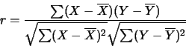
Pearson Correlation
Covariance of two variables divided by the product of their standard deviations

Slide 4
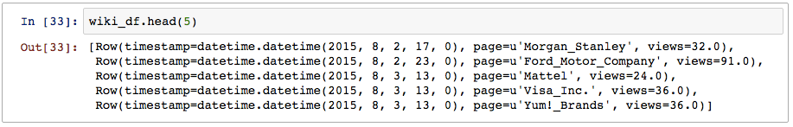
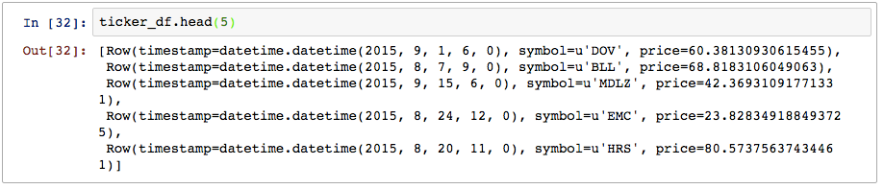
Create a Spark RDD of observations

Slide 5
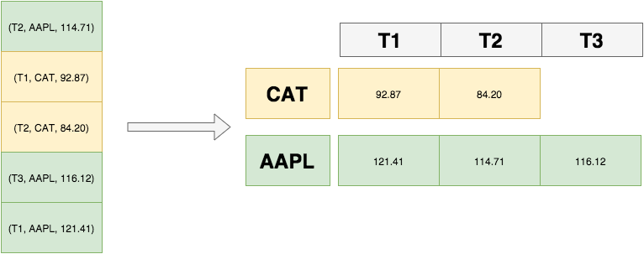
A time series is more than a pile of observations.

Slide 6
Spark-Timeseries

Slide 7

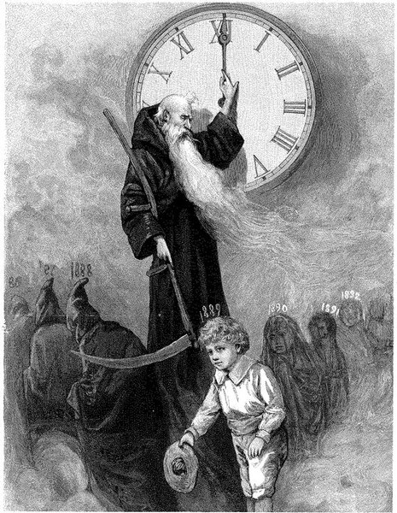
Spark-Timeseries
Library for manipulating and analyzing large-scale time series data
Github: https://github.com/cloudera/spark-timeseries
Doc: http://cloudera.github.io/spark-timeseries/

Slide 8
Observations
Timestamp | Symbol | Price
2015-04-10 | AAPL | 2.0
2015-04-11 | AAPL | 3.0
2015-04-10 | MSFT | 4.5
2015-04-11 | MSFT | 1.5
2015-04-10 | GOOG | 6.0
schema = StructType([
StructField(‘timestamp’, TimestampType()), \
StructField(‘symbol’, StringType()), \
StructField(‘price’, DoubleType()) \
])
ticker_obs = sqlCtx.createDataFrame(row_rdd, schema)

Slide 9
Time samples
Timestamp | AAPL | MSFT | GOOG
2015-04-10 | 2.0 | 4.5 | 6.0
2015-04-11 | 3.0 | 1.5 | NaN

Slide 10
Time series
DateTimeIndex: [2015-04-10, 2015-04-11]
Symbol | Series
AAPL | [2.0, 3.0]
MSFT | [4.5, 1.5]
GOOG | [6.0, NaN]

Slide 11
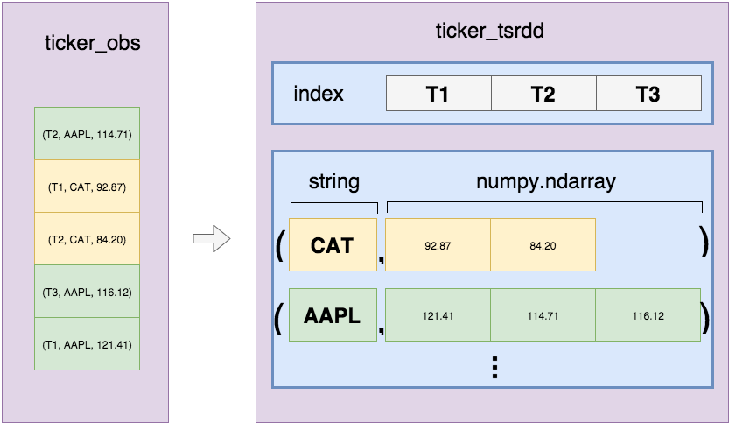
Transform observations into time series

Slide 12

Time to code
https://flic.kr/p/8RcFUD

Slide 13

Apple
https://flic.kr/p/8d4XB3

Slide 14
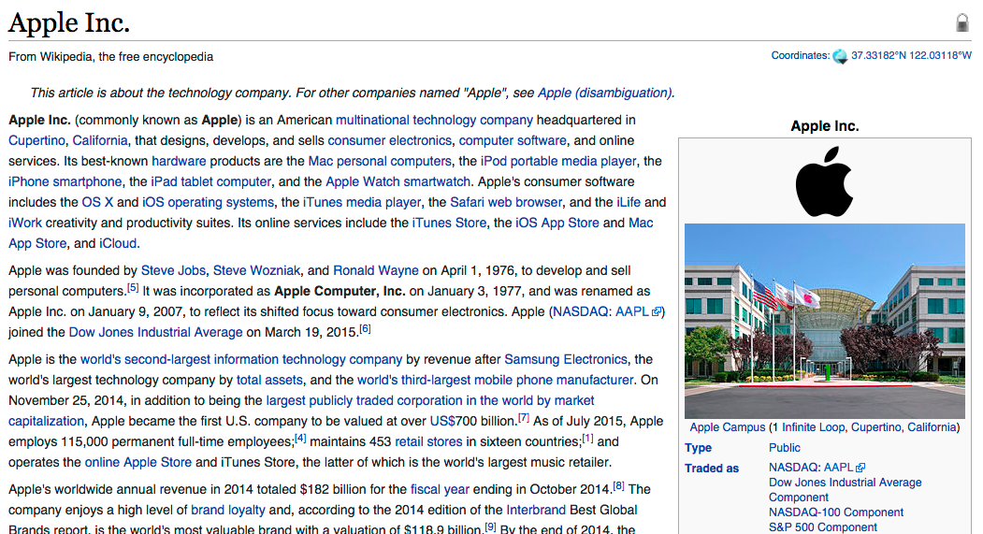
What’s the correlation between AAPL and en.wikipedia.org/wiki/Apple_Inc.?
Wiki Page:

Slide 15
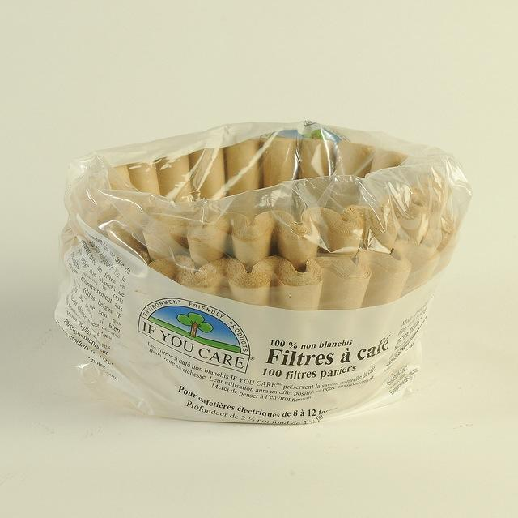
Data Quality and NaNs
https://flic.kr/p/bnnHaP

Slide 16
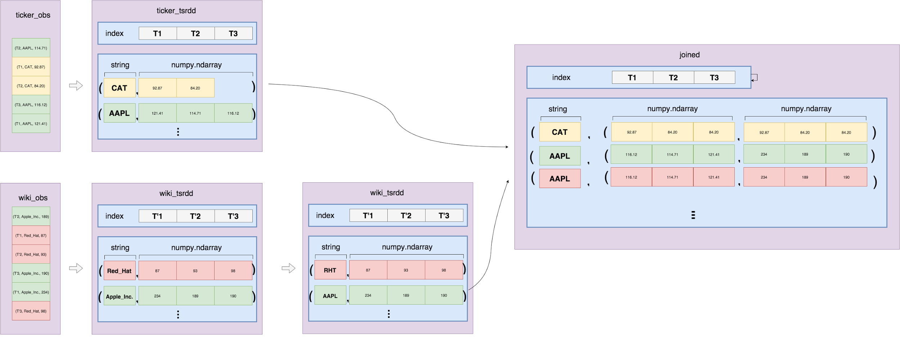
Link symbols and pages

Slide 17
Ask focused questions

Slide 18

Volatility
Measure of variety or variation of a time series
https://flic.kr/p/dtWHy

Slide 19

Magic
Magnitude
Articulation
Generality
Interestingness
Credibility
https://flic.kr/p/a4h8WE

Slide 20
Magic
Magnitude
Articulation
Generality
Interestingness
Credibility
What is our question? How are we quantifying and measuring?
https://flic.kr/p/a4h8WE

Slide 21
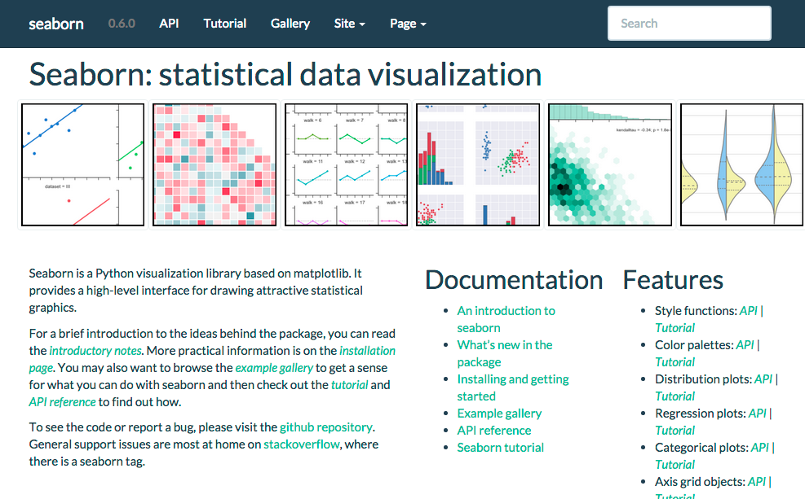
Statistical Plotting: Seaborn
http://stanford.edu/~mwaskom/software/seaborn/

Slide 22
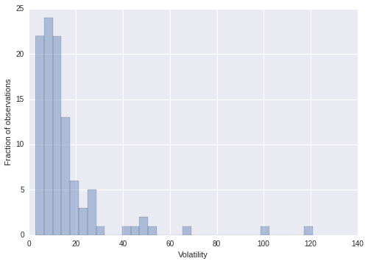
Distribution of Volatility
http://stanford.edu/~mwaskom/software/seaborn/

Slide 23
Regression as a measure of effect

Slide 24

Linear Regression using sklearn
http://scikit-learn.org/stable/documentation.html

Slide 25
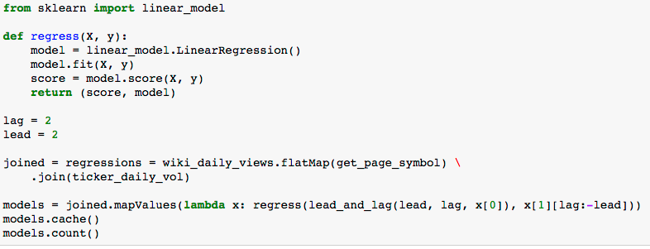
Linear Regression using sklearn

Slide 26
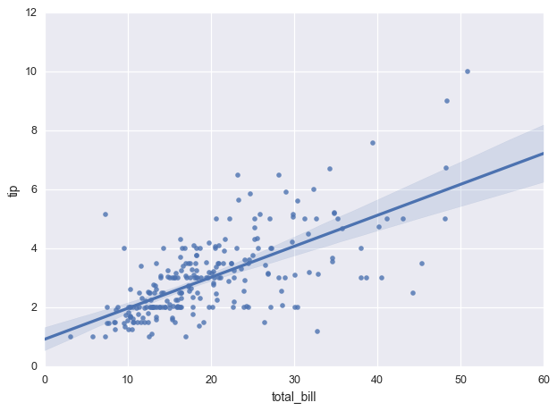
Linear Regression using seaborn

Slide 27

Why regression when we have correlation?
https://flic.kr/p/8mNZ6r

Slide 28
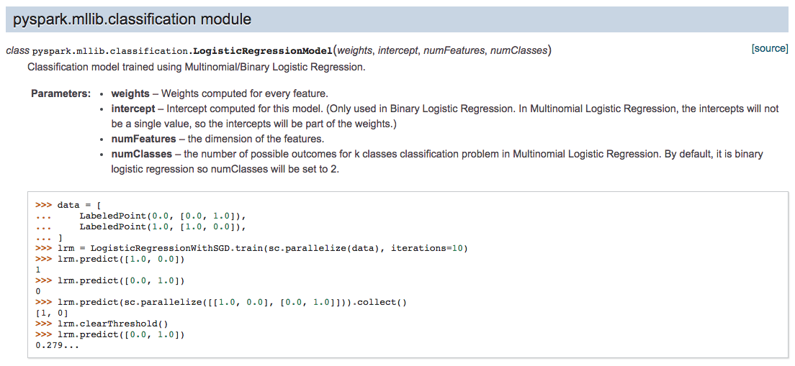
If you need to fit a linear model over all of your data
https://flic.kr/p/8mNZ6r

Slide 29
Identifying Outliers

Slide 30

When are “unusual” events occurring?
https://flic.kr/p/bn9tsC

Slide 31
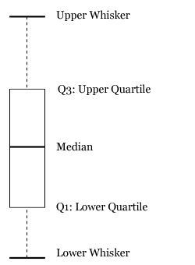
Tukey’s criterion
Tukey's boxplot criterion for outlier identification
Non-parametric: doesn’t need to assume particular probability distribution over daily purchases
Robust to outliers: focusing on interquartile range means we sidestep effects of anomalies

Slide 32
Black Monday
August 24th, 2015

Slide 33

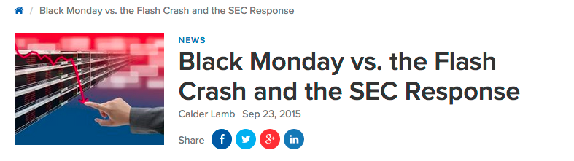
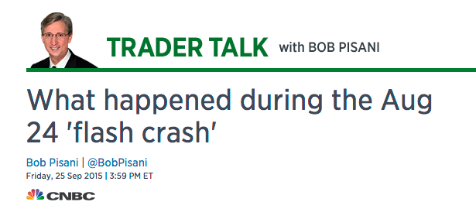

Slide 34
What happened?
Which stocks had the largest overnight drop from end of August 23rd to open August 24th?
Which stocks saw the most volatility that day?

Slide 35
Hue: cdh4.srowen.com:8888 srowen/srowen ipython: cdh1.srowen.com:8880 user11.ipynb Spark: cdh1.srowen.com:4040 (redirects) HDFS: /user/srowen/user11 | Hue: cdh4.srowen.com:8888 srowen/srowen ipython: cdh1.srowen.com:8880 user12.ipynb Spark: cdh1.srowen.com:4041 (redirects) HDFS: /user/srowen/user12
Hue: cdh4.srowen.com:8888 srowen/srowen ipython: cdh1.srowen.com:8880 user13.ipynb Spark: cdh1.srowen.com:4042 (redirects) HDFS: /user/srowen/user13 | Hue: cdh4.srowen.com:8888 srowen/srowen ipython: cdh1.srowen.com:8880 user14.ipynb Spark: cdh1.srowen.com:4043 (redirects) HDFS: /user/srowen/user14
Hue: cdh4.srowen.com:8888 srowen/srowen ipython: cdh1.srowen.com:8880 user15.ipynb Spark: cdh1.srowen.com:4044 (redirects) HDFS: /user/srowen/user15 | Hue: cdh4.srowen.com:8888 srowen/srowen ipython: cdh1.srowen.com:8880 user16.ipynb Spark: cdh1.srowen.com:4045 (redirects) HDFS: /user/srowen/user16
Hue: cdh4.srowen.com:8888 srowen/srowen ipython: cdh1.srowen.com:8880 user17.ipynb Spark: cdh1.srowen.com:4046 (redirects) HDFS: /user/srowen/user17 | Hue: cdh4.srowen.com:8888 srowen/srowen ipython: cdh1.srowen.com:8880 user18.ipynb Spark: cdh1.srowen.com:4047 (redirects) HDFS: /user/srowen/user18

Slide 36
Hue: cdh4.srowen.com:8888 srowen/srowen ipython: cdh2.srowen.com:8880 user21.ipynb Spark: cdh2.srowen.com:4040 (redirects) HDFS: /user/srowen/user21 | Hue: cdh4.srowen.com:8888 srowen/srowen ipython: cdh2.srowen.com:8880 user22.ipynb Spark: cdh2.srowen.com:4041 (redirects) HDFS: /user/srowen/user22
Hue: cdh4.srowen.com:8888 srowen/srowen ipython: cdh2.srowen.com:8880 user23.ipynb Spark: cdh2.srowen.com:4042 (redirects) HDFS: /user/srowen/user23 | Hue: cdh4.srowen.com:8888 srowen/srowen ipython: cdh2.srowen.com:8880 user24.ipynb Spark: cdh2.srowen.com:4043 (redirects) HDFS: /user/srowen/user24
Hue: cdh4.srowen.com:8888 srowen/srowen ipython: cdh2.srowen.com:8880 user25.ipynb Spark: cdh2.srowen.com:4044 (redirects) HDFS: /user/srowen/user25 | Hue: cdh4.srowen.com:8888 srowen/srowen ipython: cdh2.srowen.com:8880 user26.ipynb Spark: cdh2.srowen.com:4045 (redirects) HDFS: /user/srowen/user26
Hue: cdh4.srowen.com:8888 srowen/srowen ipython: cdh2.srowen.com:8880 user27.ipynb Spark: cdh2.srowen.com:4046 (redirects) HDFS: /user/srowen/user27 | Hue: cdh4.srowen.com:8888 srowen/srowen ipython: cdh2.srowen.com:8880 user28.ipynb Spark: cdh2.srowen.com:4047 (redirects) HDFS: /user/srowen/user28

Slide 37
Hue: cdh4.srowen.com:8888 srowen/srowen ipython: cdh3.srowen.com:8880 user31.ipynb Spark: cdh3.srowen.com:4040 (redirects) HDFS: /user/srowen/user31 | Hue: cdh4.srowen.com:8888 srowen/srowen ipython: cdh3.srowen.com:8880 user32.ipynb Spark: cdh3.srowen.com:4041 (redirects) HDFS: /user/srowen/user32
Hue: cdh4.srowen.com:8888 srowen/srowen ipython: cdh3.srowen.com:8880 user33.ipynb Spark: cdh3.srowen.com:4042 (redirects) HDFS: /user/srowen/user33 | Hue: cdh4.srowen.com:8888 srowen/srowen ipython: cdh3.srowen.com:8880 user34.ipynb Spark: cdh3.srowen.com:4043 (redirects) HDFS: /user/srowen/user34
Hue: cdh4.srowen.com:8888 srowen/srowen ipython: cdh3.srowen.com:8880 user35.ipynb Spark: cdh3.srowen.com:4044 (redirects) HDFS: /user/srowen/user35 | Hue: cdh4.srowen.com:8888 srowen/srowen ipython: cdh3.srowen.com:8880 user36.ipynb Spark: cdh3.srowen.com:4045 (redirects) HDFS: /user/srowen/user36
Hue: cdh4.srowen.com:8888 srowen/srowen ipython: cdh3.srowen.com:8880 user37.ipynb Spark: cdh3.srowen.com:4046 (redirects) HDFS: /user/srowen/user37 | Hue: cdh4.srowen.com:8888 srowen/srowen ipython: cdh3.srowen.com:8880 user38.ipynb Spark: cdh3.srowen.com:4047 (redirects) HDFS: /user/srowen/user38

Slide 38
Hue: cdh4.srowen.com:8888 srowen/srowen ipython: cdh4.srowen.com:8880 user41.ipynb Spark: cdh4.srowen.com:4040 (redirects) HDFS: /user/srowen/user41 | Hue: cdh4.srowen.com:8888 srowen/srowen ipython: cdh4.srowen.com:8880 user42.ipynb Spark: cdh4.srowen.com:4041 (redirects) HDFS: /user/srowen/user42
Hue: cdh4.srowen.com:8888 srowen/srowen ipython: cdh4.srowen.com:8880 user43.ipynb Spark: cdh4.srowen.com:4042 (redirects) HDFS: /user/srowen/user43 | Hue: cdh4.srowen.com:8888 srowen/srowen ipython: cdh4.srowen.com:8880 user44.ipynb Spark: cdh4.srowen.com:4043 (redirects) HDFS: /user/srowen/user44
Hue: cdh4.srowen.com:8888 srowen/srowen ipython: cdh4.srowen.com:8880 user45.ipynb Spark: cdh4.srowen.com:4044 (redirects) HDFS: /user/srowen/user45 | Hue: cdh4.srowen.com:8888 srowen/srowen ipython: cdh4.srowen.com:8880 user46.ipynb Spark: cdh4.srowen.com:4045 (redirects) HDFS: /user/srowen/user46
Hue: cdh4.srowen.com:8888 srowen/srowen ipython: cdh4.srowen.com:8880 user47.ipynb Spark: cdh4.srowen.com:4046 (redirects) HDFS: /user/srowen/user47 | Hue: cdh4.srowen.com:8888 srowen/srowen ipython: cdh4.srowen.com:8880 user48.ipynb Spark: cdh4.srowen.com:4047 (redirects) HDFS: /user/srowen/user48

Slide 39
Hue: cdh4.srowen.com:8888 srowen/srowen ipython: cdh5.srowen.com:8880 user51.ipynb Spark: cdh5.srowen.com:4040 (redirects) HDFS: /user/srowen/user51 | Hue: cdh4.srowen.com:8888 srowen/srowen ipython: cdh5.srowen.com:8880 user52.ipynb Spark: cdh5.srowen.com:4041 (redirects) HDFS: /user/srowen/user52
Hue: cdh4.srowen.com:8888 srowen/srowen ipython: cdh5.srowen.com:8880 user53.ipynb Spark: cdh5.srowen.com:4042 (redirects) HDFS: /user/srowen/user53 | Hue: cdh4.srowen.com:8888 srowen/srowen ipython: cdh5.srowen.com:8880 user54.ipynb Spark: cdh5.srowen.com:4043 (redirects) HDFS: /user/srowen/user54
Hue: cdh4.srowen.com:8888 srowen/srowen ipython: cdh5.srowen.com:8880 user55.ipynb Spark: cdh5.srowen.com:4044 (redirects) HDFS: /user/srowen/user55 | Hue: cdh4.srowen.com:8888 srowen/srowen ipython: cdh5.srowen.com:8880 user56.ipynb Spark: cdh5.srowen.com:4045 (redirects) HDFS: /user/srowen/user56
Hue: cdh4.srowen.com:8888 srowen/srowen ipython: cdh5.srowen.com:8880 user57.ipynb Spark: cdh5.srowen.com:4046 (redirects) HDFS: /user/srowen/user57 | Hue: cdh4.srowen.com:8888 srowen/srowen ipython: cdh5.srowen.com:8880 user58.ipynb Spark: cdh5.srowen.com:4047 (redirects) HDFS: /user/srowen/user58

